Slide 1


MEDIA & THE PUBLIC
Week 4 Agenda setting in new media
Ryan Wang
ryanyang@psu.edu

Slide 2
Variants of agenda-setting
Reality
selection, omission & framing
Agenda
Perceived reality

Slide 3
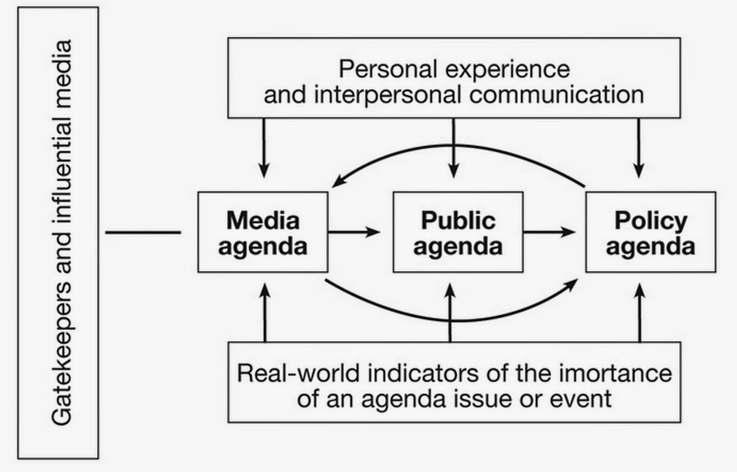
Variants of agenda-setting: agenda building

Slide 4
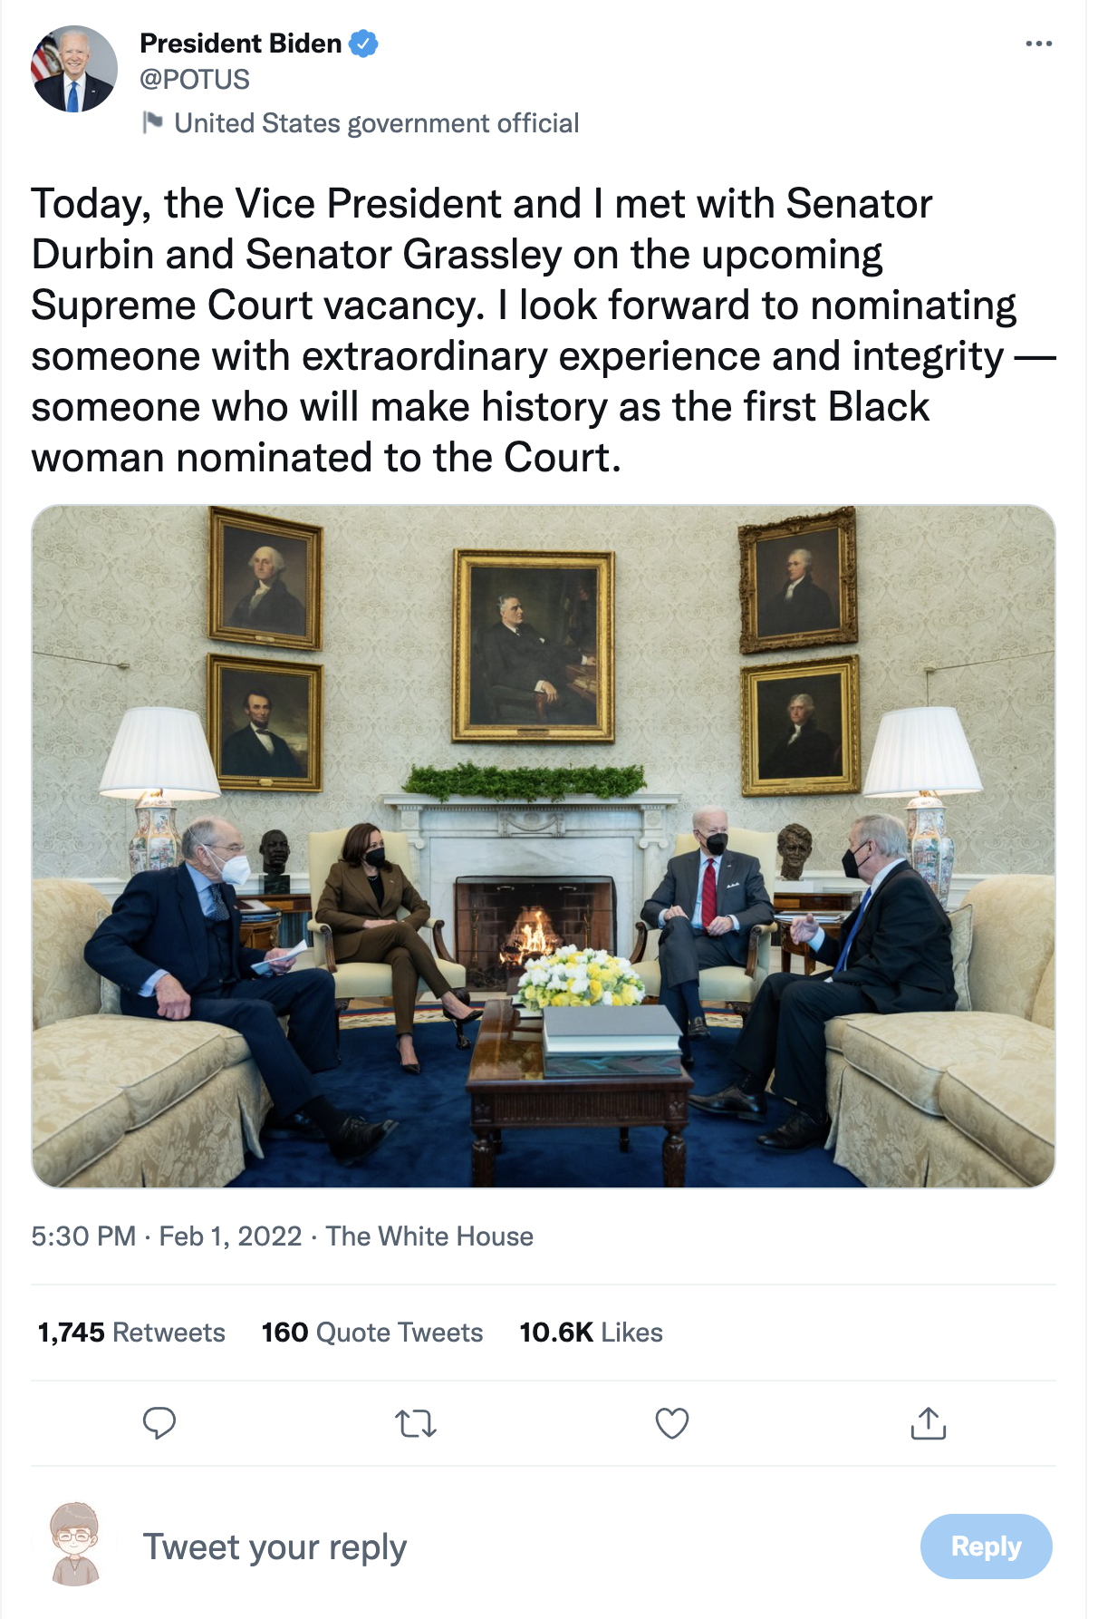
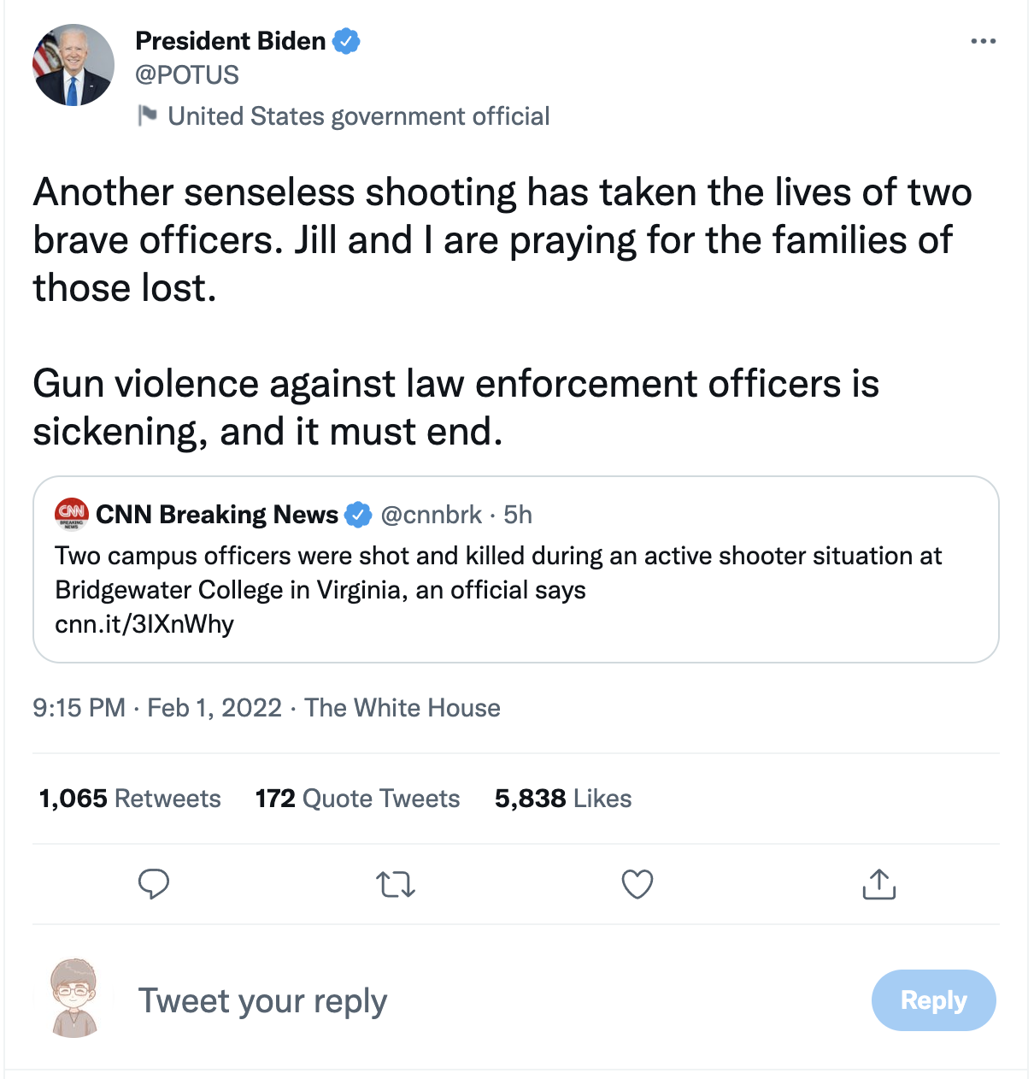
Why Twitter is political?

Slide 5
Is Twitter representative?
NOT AT ALL!!!

Slide 6
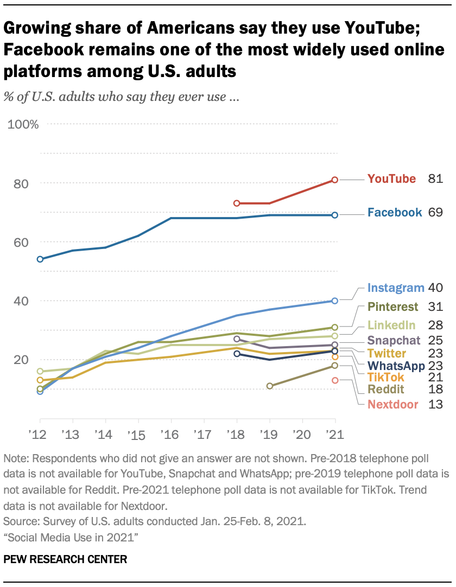
Source: Pew Research Center

Slide 7
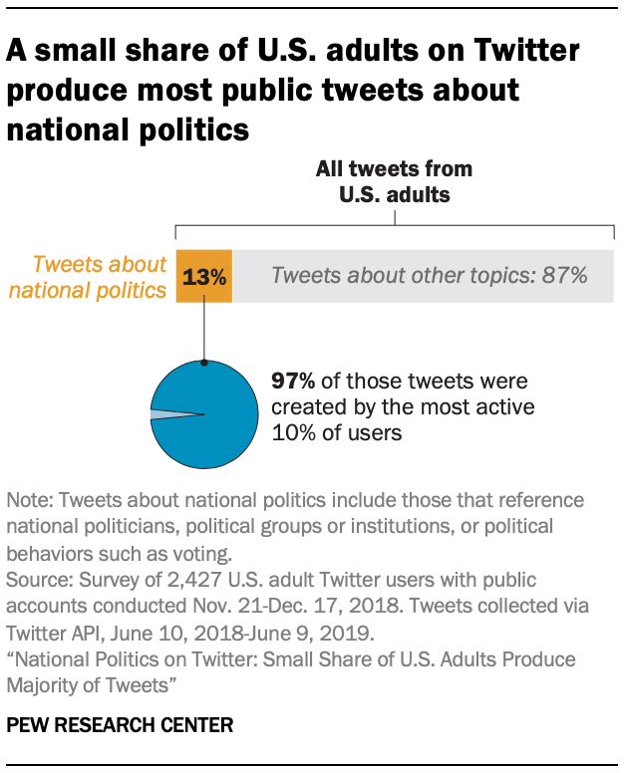
Source: Pew Research Center

Slide 8
Background: Issue ownership theory
Issue ownership theory suggests that candidates should focus on the issues that are owned by—or associated with—their parties and mostly avoid issues that are owned by the opposing party.

Slide 9

The more attacks, the more retweets: Trump’s and Clinton’s agenda setting on Twitter
(Lee & Xu, 2018)

Slide 10
DON’T TRY TO READ EVERYTHING!
WHAT IS THE MAIN POINT OF THIS PAPER?
WHAT IS THE MAIN RESULT?
What are the hypotheses and research questions
WHAT DATA ARE THEY USING?
WHAT METHOD DO THEY USE?
Measurement: how did they code?
How to they get to the result?

Slide 11
What are the main points?
H1: Issues that are emphasized on candidates’ campaign websites are emphasized in their tweets.
H2: Through tweets, candidates emphasize issues owned by their parties.
H3: Issues emphasized by candidates are retweeted and favorited more.
RQ1: How common are attack tweets in candidates’ campaign tweets?
RQ2: Do attack tweets receive significantly more retweets and favorites?
RQ3: How are Trump’s and Clinton’s uses of multimedia, links, or hashtags, and message originality different?

Slide 12
What data are they using? How do they measure?
Data:
Measure:

Slide 13
What data are they using? How do they measure?
Data:
All original tweets posted by @RealDonaldTrump (Donald J. Trump) and @ HillaryClinton (Hillary Clinton) between August 1 and October 31, 2016. (note: Other-created messages were also included in the sample if they were modified by the candidates before sharing. The total number of sampled tweets was 1575 (551 for Trump; 1024 for Clinton)
During the sampled 92 days, in average, Trump’s tweet received 11,206 retweets and 27,494 favorites, which are three times as many as Clinton’s average retweets (3795) and favorites (8567).
Measure:
Attack
Issues
Time
Hashtags
Message originality
Multimedia or links

Slide 14
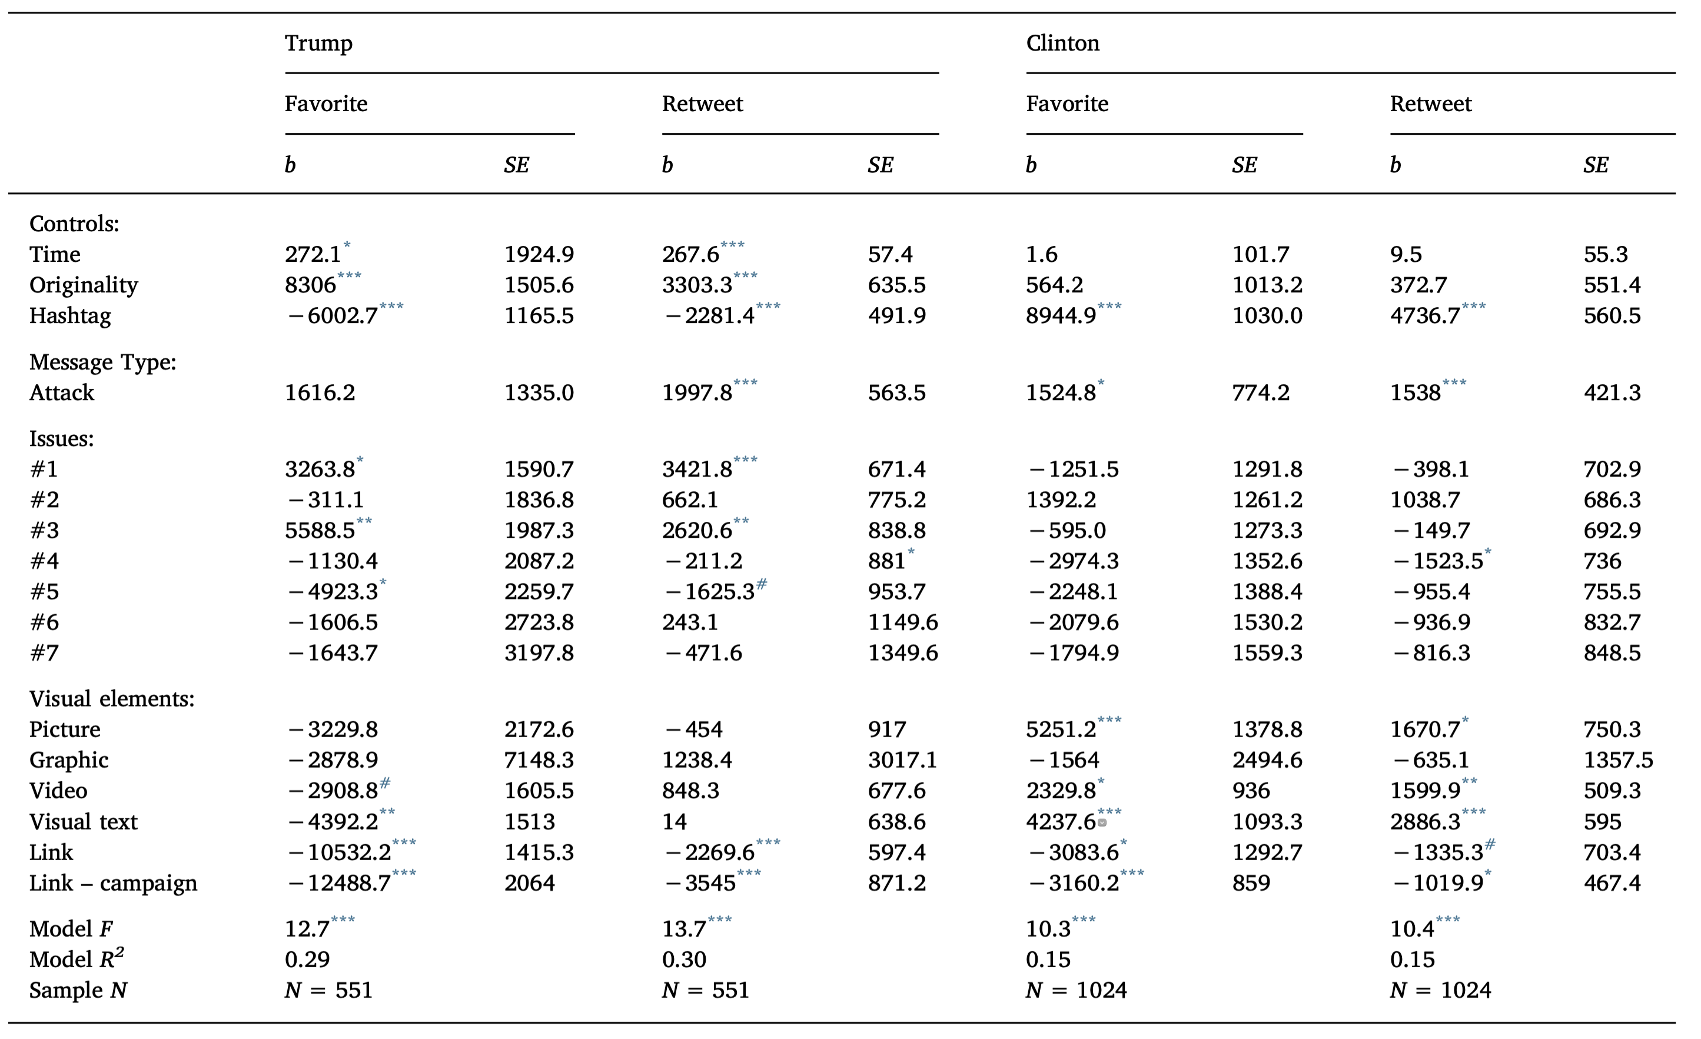

Slide 15
What are the main points?
H1: Issues that are emphasized on candidates’ campaign websites are emphasized in their tweets.
H2: Through tweets, candidates emphasize issues owned by their parties.
H3: Issues emphasized by candidates are retweeted and favorited more.

Slide 16
What are the main results?
H1: Issues that are emphasized on candidates’ campaign websites are emphasized in their tweets. (Support)
Trump: Gov/Establishment; Media bias; National security; Economy/Jobs; Immigration;
Clinton: Women’s rights; Racial/religious issues; Inequality; Economy/jobs; Veterans; Education; National security
H2: Through tweets, candidates emphasize issues owned by their parties (Partially support).
Trump: National security; Foreign policy
Attach the Establishment and opponents
Clinton: Women’s rights; Racial/religious issues; Inequality; Veterans; Education
H3: Issues emphasized by candidates are retweeted and favorited more (Support for Trump but not for Clinton).

Slide 17
What are the main results?
H3: Issues emphasized by candidates are retweeted and favorited more (Support for Trump but not for Clinton).
Trump
“Media bias” leads to more favorites (b = 6850, p = 0.001) and retweets (b = 2860, p < 0.001).
“Opponent’s problem” leads to more retweets (b = 2966.2, p < 0.001).
“Economy” leads to less favorites (b = −5119.5, p = 0.034)
Time(closer to election date) and message originality are both positive predictors for retweet; but not hashtag usage
Clinton
None of the top 7 issues are effective in attracting more voter reactions
“Income inequality” was a negative predictor of both favorites (b = −3335.6, p = 0.016) and retweets (b = −1752.2, p = 0.019)
“The economy” negatively predicts favorites (b = −2926.1, p = 0.039), and is a marginally significant negative predictor of retweets (b = −1292.8, p = 0.092)
“Women’s rights” hints a positive relationship with retweets, marginally significant (b = 1189.1, p = 0.088)
Only hashtags positively and significantly predicted both favorites (b = 9415.4, p < 0.001) and retweets (b = 5012.1, p < 0.001).

Slide 18
What are the main points?
RQ1: How common are attack tweets in candidates’ campaign tweets?
RQ2: Do attack tweets receive significantly more retweets and favorites?
RQ3: How are Trump’s and Clinton’s uses of multimedia, links, or hashtags, and message originality different?

Slide 19
What are the main results?
RQ1: How common are attack tweets in candidates’ campaign tweets?
Trump: 53.9%
Clinton, Obama, other politicians, and the media
Clinton: 48.7%
Trump, Pence, James Comey
RQ2: Do attack tweets receive significantly more retweets and favorites? (YES!)
Trump
Favorites: b = 2921.1, p = 0.03; Retweet: b = 2213.2, p < 0.001
Clinton
Favorites: b = 1638, p = 0.035); Retweets (b = 1593.5, p < 0.001).

Slide 20
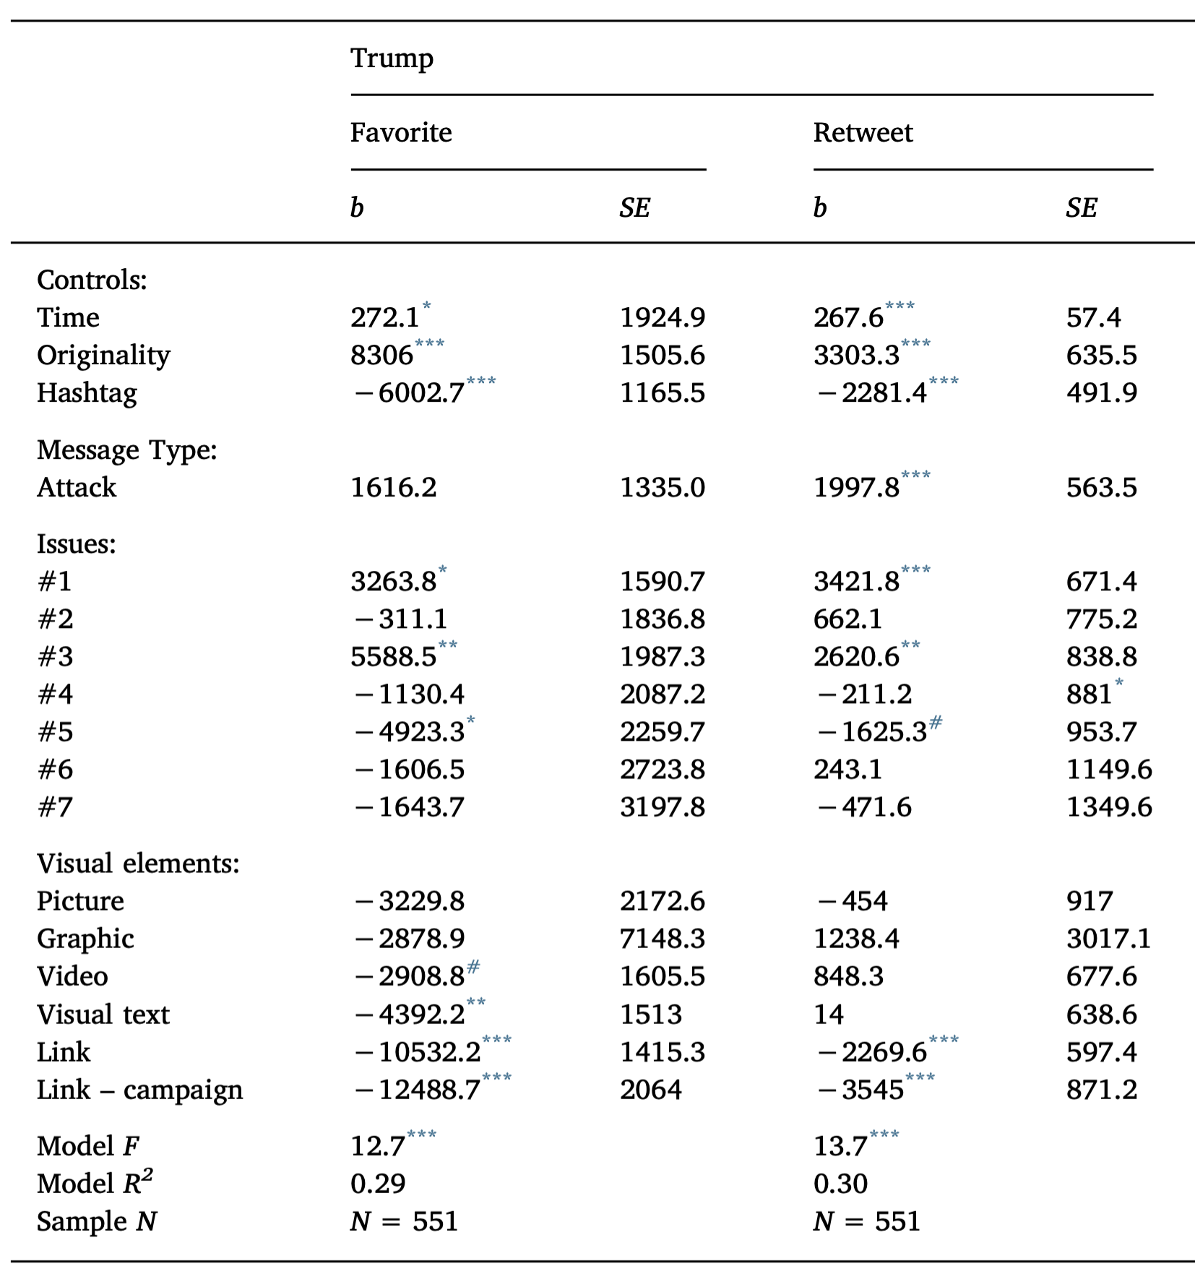
What are the main results?
RQ3: How are Trump’s and Clinton’s uses of multimedia, links, or hashtags, and message originality different?
Trump: Visual texts, links to his campaign website, and links to a non-campaign website were all negative predictors of favorites

Slide 21
What are the main results?
RQ3: How are Trump’s and Clinton’s uses of multimedia, links, or hashtags, and message originality different?
Clinton: pictures, videos, and visual texts all positively and significantly predicted favorites and retweets for Clinton.

Slide 22
Conclusion and critique
Conclusion
Twitter is increasingly playing a role as an extension of campaign websites when political candidates try to build their agenda.
Trump and Clinton mainly used it as a channel to deliver negative messages about their political opponents.
Candidates’ attack tweets were effective in drawing voter reactions (“adversarial campaign”).
Trump’s campaign on Twitter is successful
Limitation
It is not actually examining the agenda-building effect
Generalizability?
Time validity?

